Slide 1
Portfolio Template
Follow These Steps To Use This Template

Slide 2
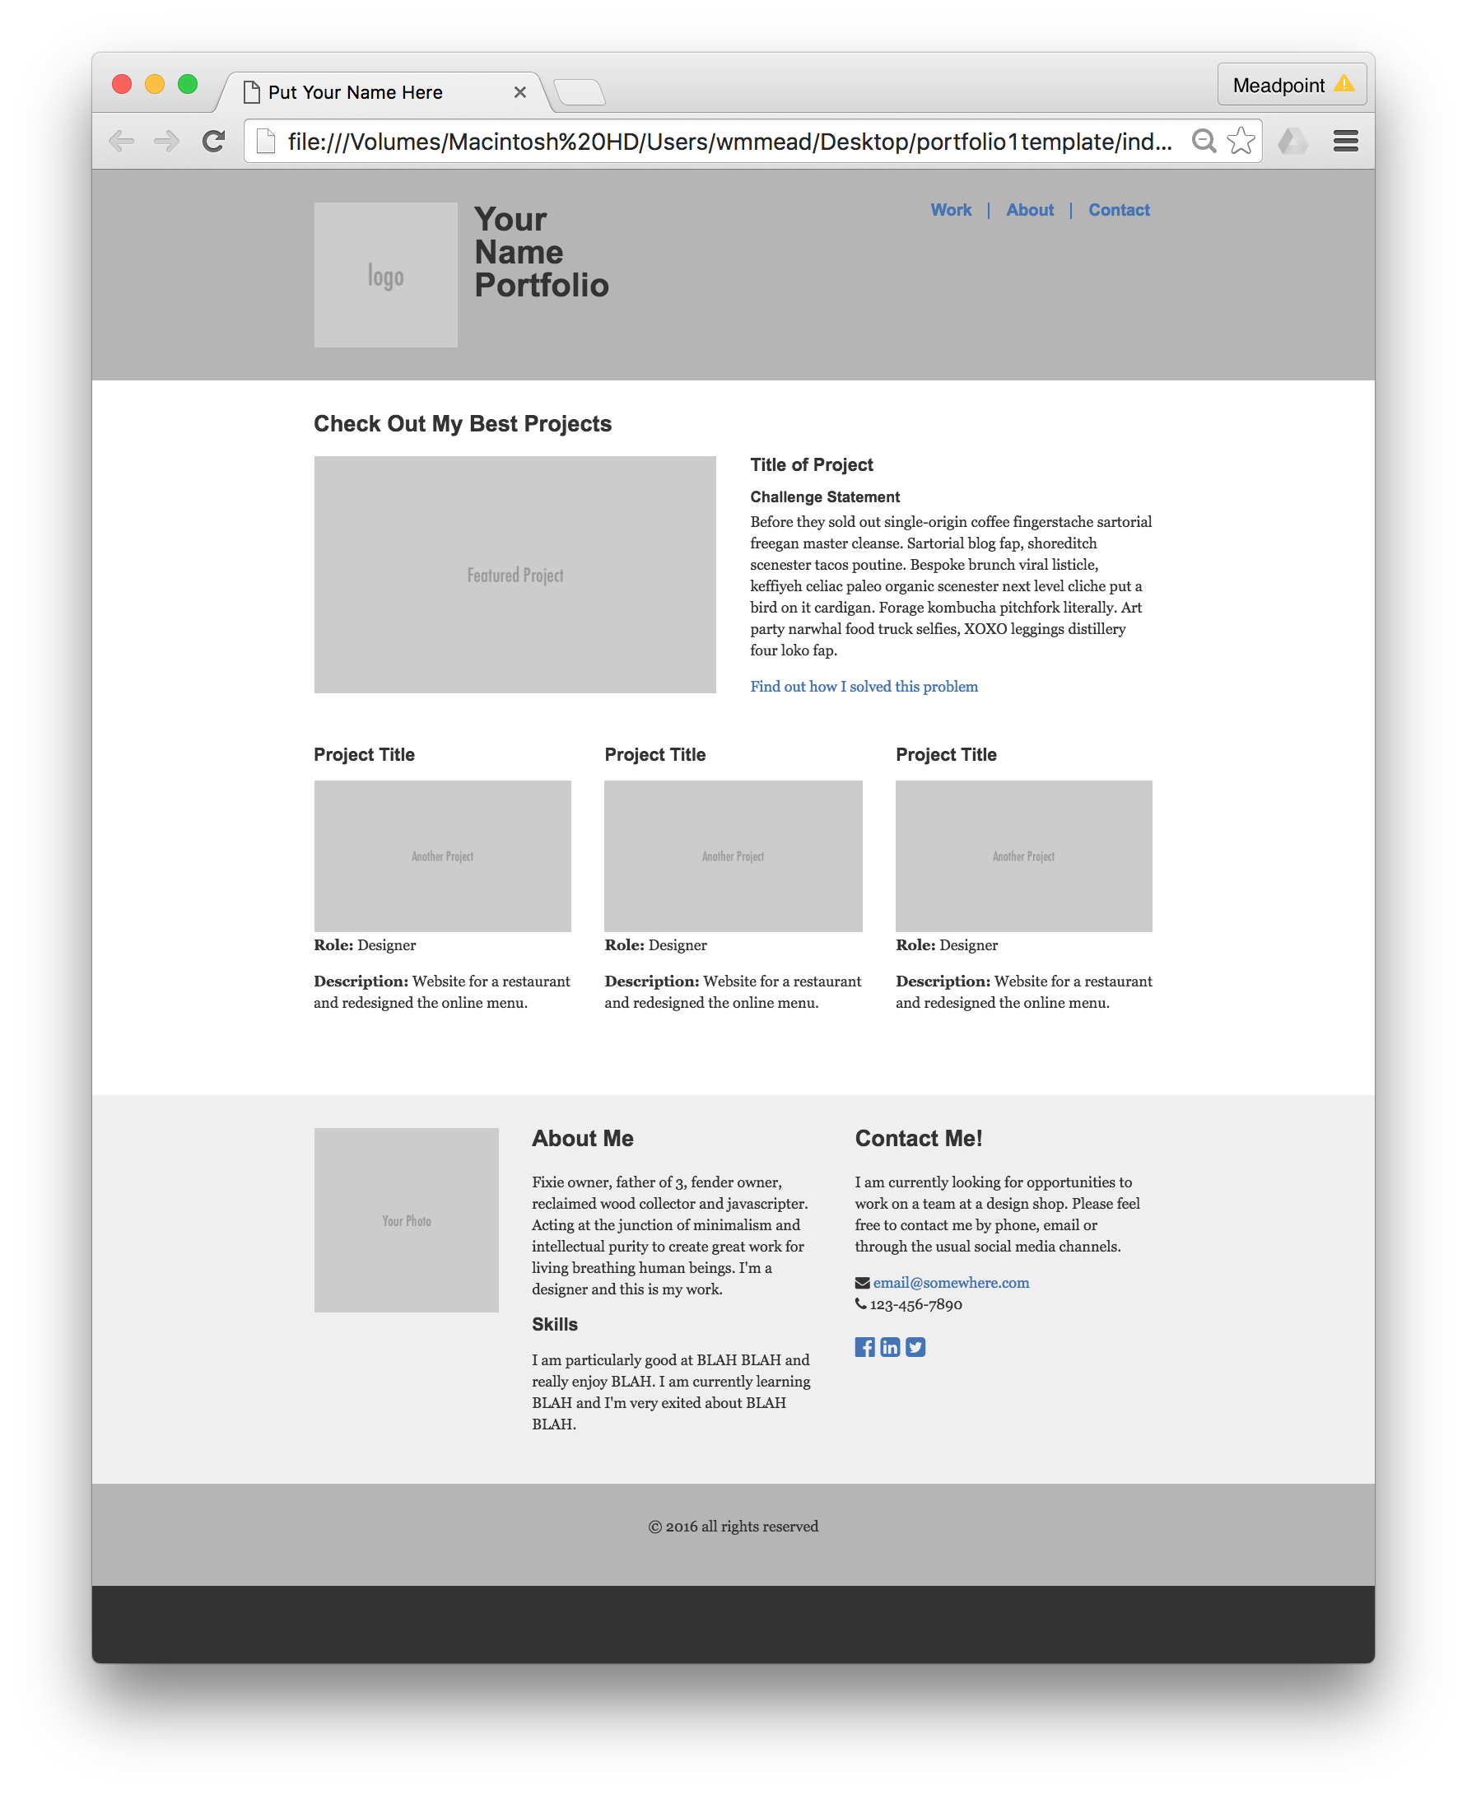
This template is designed to help you build a simple portfolio site so that the focus can be on content, rather than building the site.
Please be sure to go through this presentation and personalize it.

Slide 3
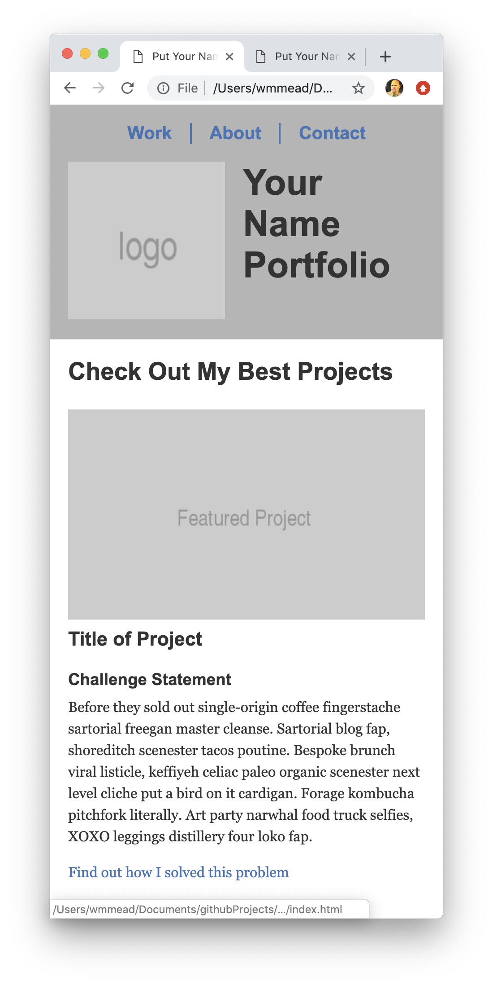
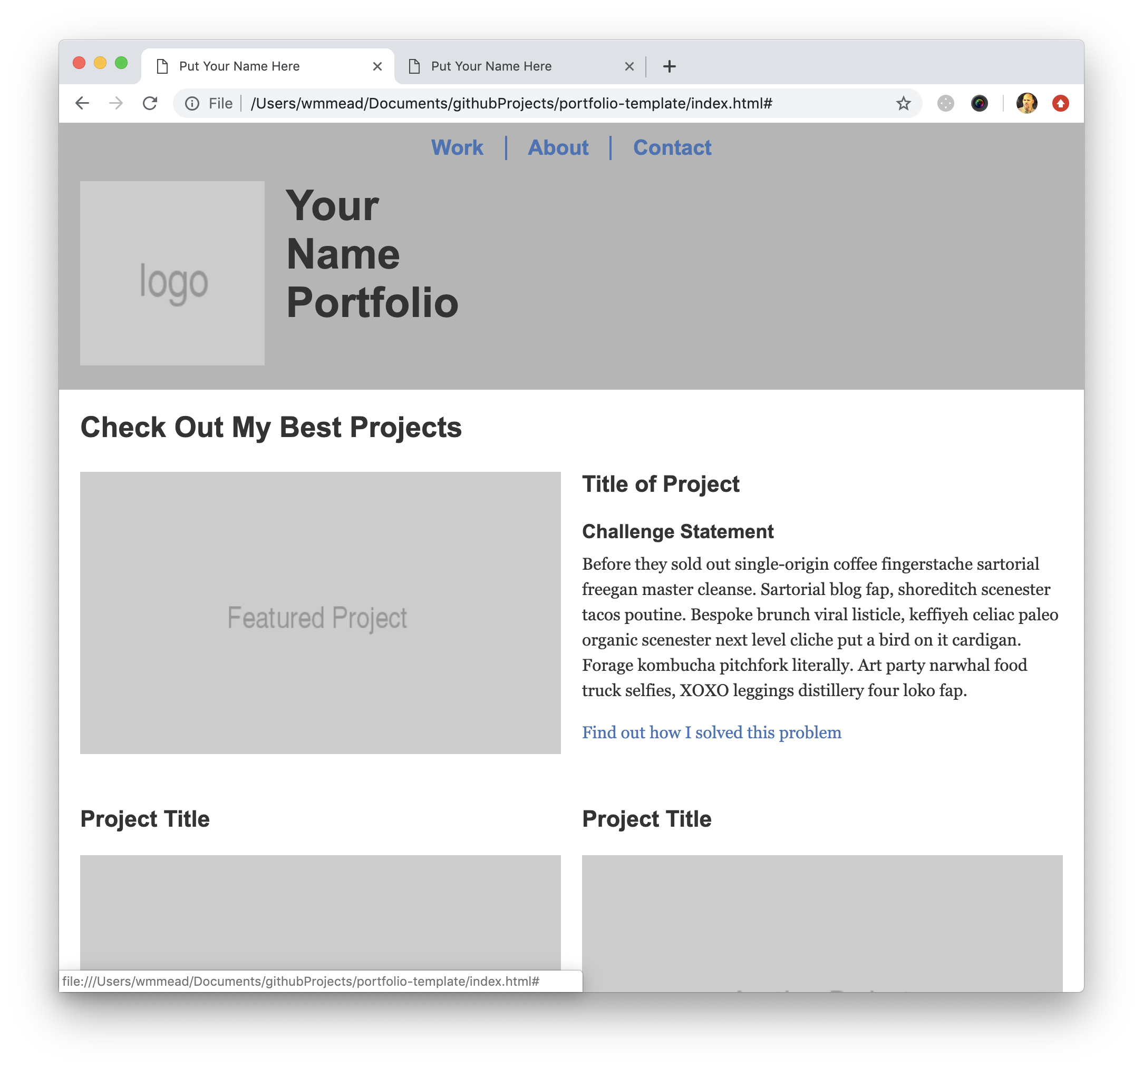
The template is responsive following a mobile first approach.

Slide 4
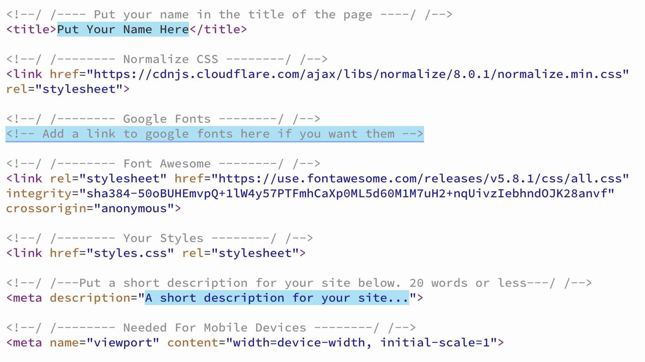
STEP 1 - Head Tag Info
Open the index.html file and change the title of the page to reflect your portfolio. Also change the description in the meta tag. Add links to Google fonts, if desired.

Slide 5
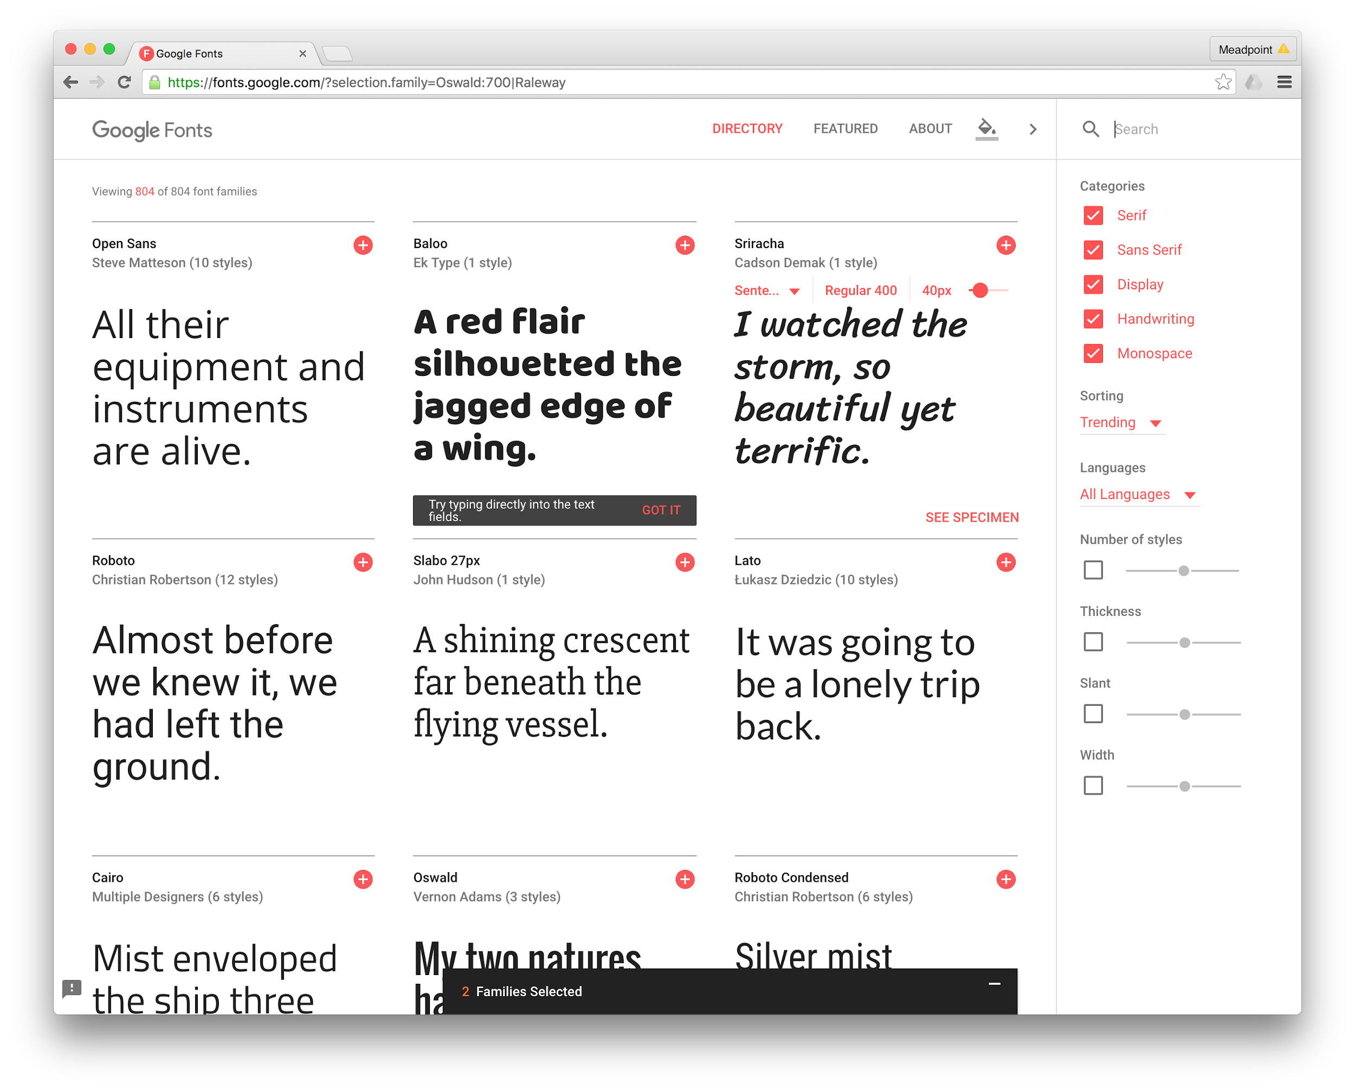
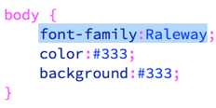
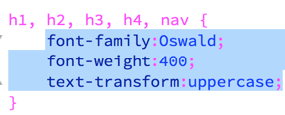
STEP 2 - Fonts
Google fonts is one good place to go for some free fonts to help give your page some personality. Be sure to pick typefaces that are easy to read and appropriate for headers and body copy.
I picked Oswald for headers and Raleway for body copy.
Add the link in the head of your HTML file and update the styles on your stylesheet to use the fonts.

Slide 6
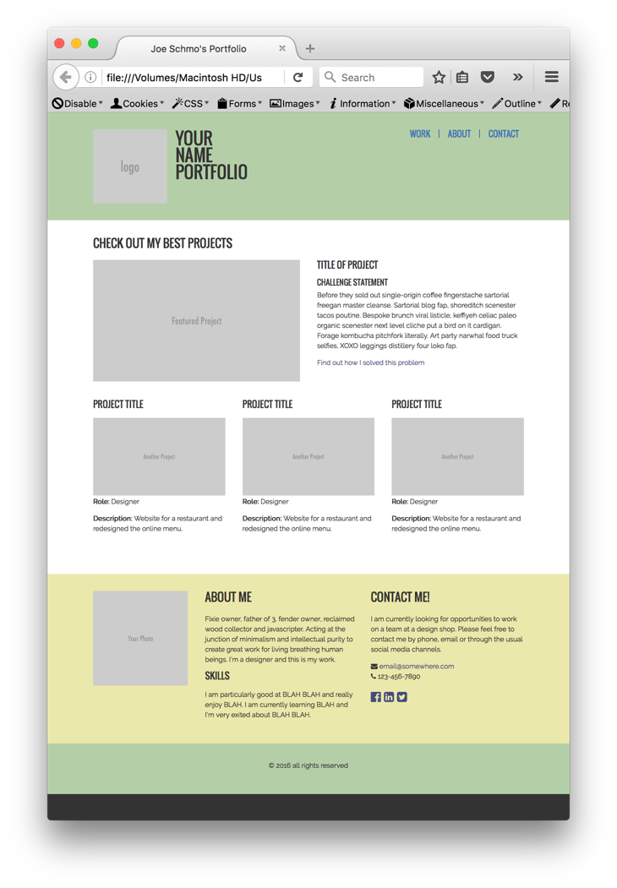

STEP 3 - Colors
Pick a color scheme and replace the primary, secondary and accent colors in the CSS. Simply do a find and replace to make sure everything is changed. Already, the site is starting to get a little personality.

Slide 7
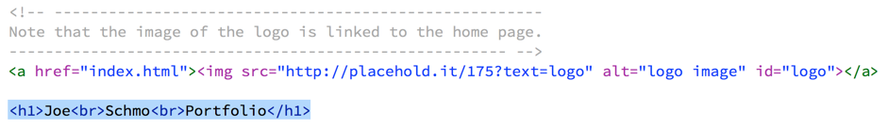

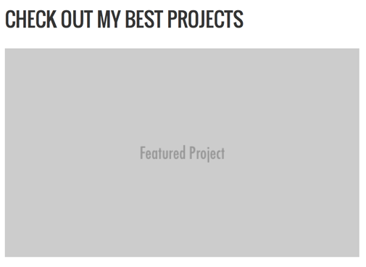
STEP 4 - Content (The Most Important Step)
Adjust the text in the H1 and get an appropriate logo image. The logo is currently set to 175px square, but could be bigger or smaller, wider or taller. You can save your logo file as a JPG, PNG or SVG. If you choose SVG, remember, you will need to specify its size in the CSS.
There is an images folder in the template folder to put your images in. Make sure you put them in that folder before linking to them.
Make sure you are cropping and/or resizing images to the proper size in Photoshop before putting them in the folder and on the page.

Slide 8
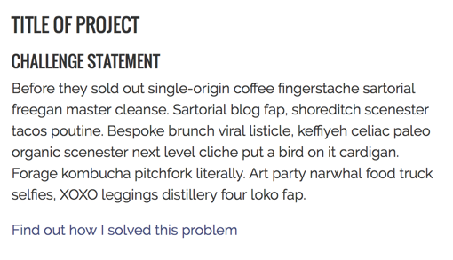
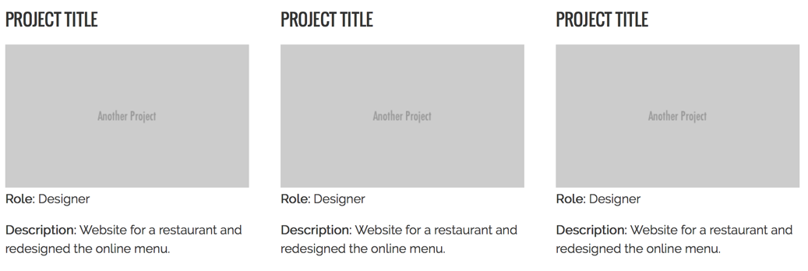
STEP 4 - Content Continued
This is the most important content on your page. Be specific about the problem and the challenges you faced as a designer and/or developer.
These can all be adjusted as necessary. I recommend having at least three other projects, the template has room for four, but you could add or subtract more. besides the main project, which should be your best and probably most recent project.

Slide 9
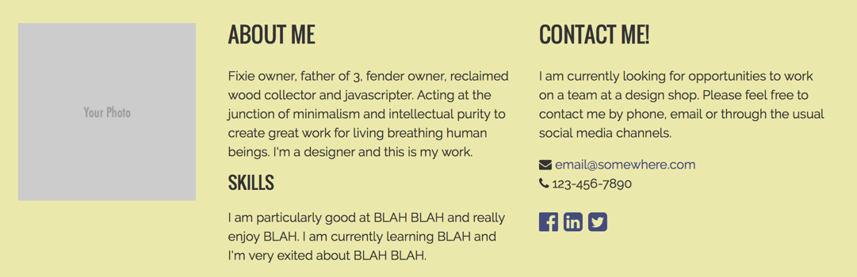
STEP 4 - Content Continued
Once someone has had a chance to see your work, tell them a little bit about you, what you are really good at and what you are looking for. Keep it simple and straight to the point.
Note the email address has been encoded using this simple email encoder. This is to prevent spammers from scraping up your email address and sending you tons of spam.
Note that font awesome has been included. You can go to the font awesome website and put additional or different icons, as needed. Just follow the example in the code.

Slide 10
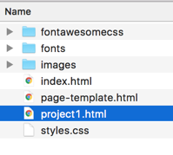
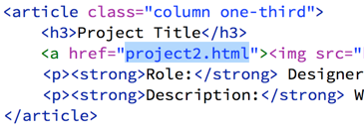
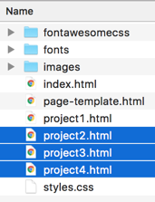
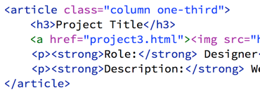
STEP 4 - Content Continued
Duplicate the page-template.html file and change the name of the file to project1.html, or something else more descriptive (remember, no spaces in file names!).
Open that file and really go into detail on this project. What did you do? Focus on why you did what you did and how you did it. You may need to add more rows and more images to show everything.
Repeat these steps for each project, then in the additional projects section, link up each page to each project page.

Slide 11
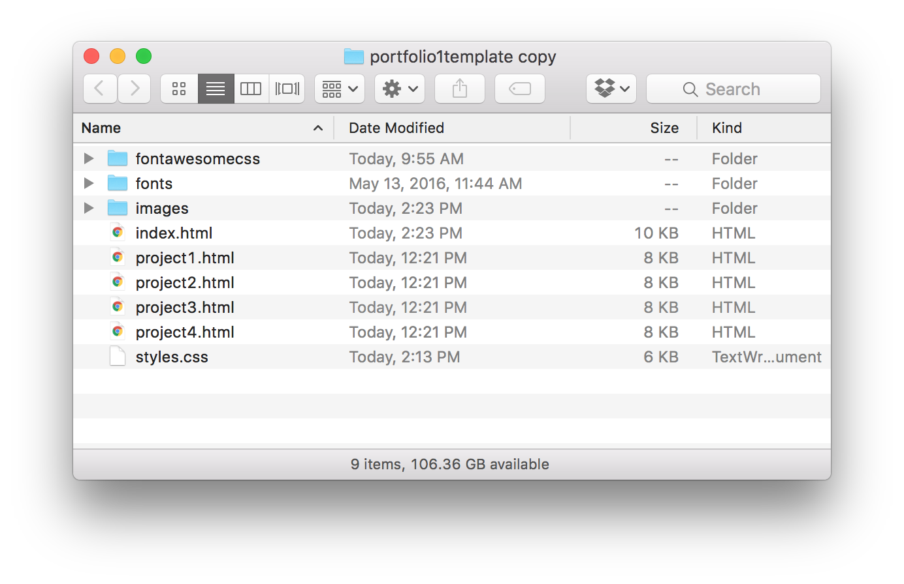
STEP 5 - File Management
When you are done, you should have an index page as the home page. The projects at the top of that page should link to each of their respective project pages.
On the project pages, there should be links to each of the other project pages.
The navigation at the top of the index page links to the work section on that page. The About and Contact links both link to the section further down on the page. On the internal pages, the Work link links to the work section on the index page, but the About and Contact sections each link to the about and contact sections on those individual pages. This content is then repeated on every page. You may want to remove it and only have it on the front page.

Slide 12
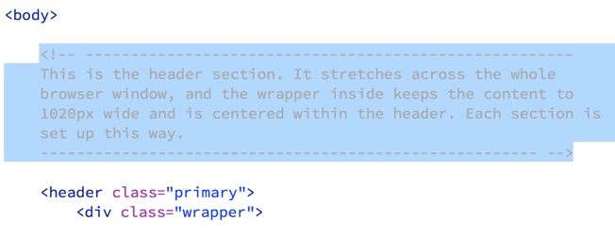
STEP 6 - Code Clean Up
Potential employers will look at your code. Make sure it is neat and tidy. Remove my comments from the code and add yours where appropriate. Keep it from looking like it’s a template!
Make sure each section is properly indented.

Slide 13
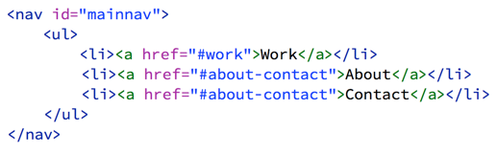

Addendum - Ideas to Make The Site Better
Add some JavaScript!
Add a smooth scroll effect for the navigation. Or perhaps add a lightbox for some of the images. Properly adding JavaScript will show off those skills.
Add a Contact Form
The contact info provided in the format on the right is fine for a simple site, but adding a contact form shows you know how to make forms and work with basic PHP and do some simple validation in JS.

